Slide 1
COT 4521: Introduction to Computational Geometry
Introduction and Preliminaries

Slide 2
PhD
Research Assistant Professor
Assistant Professor
2004
2010
2015
Problem Domain
Computer
Graphics
Scientific Visualization
Data Visualization
Problem Solving Approach
Geometric Approaches
Topological Approaches

Slide 3
Introduction
What is computational geometry?
A subfield of the Analysis of Algorithms
Design of efficient algorithms and data structures for geometrical problems
Started in mid 70’s
started out by developing solid theoretical foundations, but became more and more applied over the last years
Deals with geometrical structures
Points, lines, line segments, vectors, planes, etc.
We’ll focus mostly on 2-dimensional geometry, but 3D will be covered when possible

Slide 4
What makes Computational Geometry problems so Interesting/annoying?
Complexity
Curse of dimensionality
Precision error
Avoid floating-point computations whenever possible
Degeneracy
Boundary cases
For example, imagine how two line segments can intersect

Slide 5
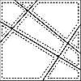
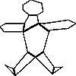
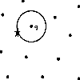
Typical Computational Geometry Problems
Voronoi diagram
simplifying polygons
shape similarity
convex hull
maintaining line arrangements
polygon partitioning
nearest neighbor search
kd-trees

Slide 6
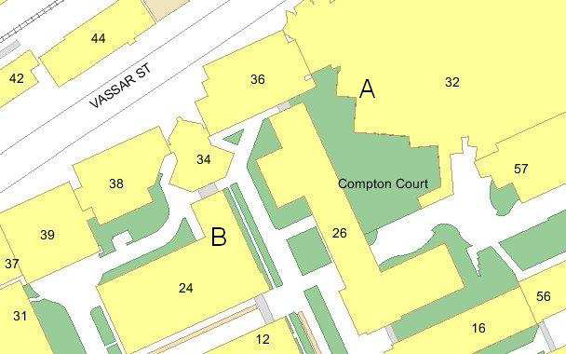
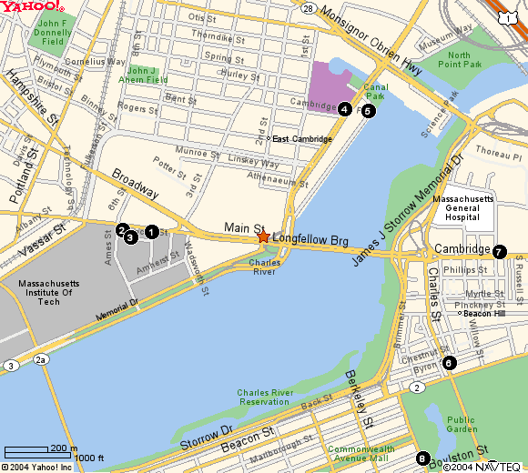
Applications
Computer Graphics
Robotics motion planning
Geographic Information
CAD/CAM
Collision detection
Computer vision
Molecular modeling
VLSI design
Data Mining, Machine Learning, and Visualization

Slide 7

Applications of Computational Geometry
Computer Graphics
For 2-dimensional graphics, typical questions involve the intersection of certain primitives, determining the subset of primitives that lie within a particular region, etc.
For 3-dimensional graphics, hidden surface removal

Slide 8


Applications of Computational Geometry
Robotic motion planning
The geometric problem arise at many places because robots are geometric objects that operate in a 3-dimensional space

Slide 9
Applications of Computational Geometry
Geographic Information system (GIS)
Stores geographical data
Can be used to extract information about certain regions and to obtain information between different types of data

Slide 10
Applications of Computational Geometry
CAD/CAM
Computer-Aided Design
Deal with intersections and unions of objects, with decompositions objects and object boundaries into simpler shapes, and with visualizing the designed products
Computer-Aided Manufacturing
Computer controls the actual manufacturing process

Slide 11
Applications of Computational Geometry
Collision detection
Check whether two (possibly complicated) 3d objects intersect!
Approximate the objects by simple ones that enclose them (bounding volumes)
Popular bounding volumes: boxes, spheres, ellipsoids,...
If bounding volumes don’t intersect, the objects don’t intersect, either
Only if bounding volumes intersect, apply more expensive intersection test(s)

Slide 12
Applications of Computational Geometry
Computer vision
Surface Reconstruction
Step 1: Scan the object (3d laser scanner)
Step 2: Create a triangulation
Step 3: process the triangulation (rendering)
smooth surface in R³
Major Computational Geometry task: Create a “good” triangulation
Pattern recognition
Example: an optical character recognition system

Slide 13
Applications of Computational Geometry
Molecular modeling
Typical questions are to compute the union of the atom balls to obtain the molecule surface or to compute where two molecules can touch each other

Slide 14
Applications of Computational Geometry
VLSI design
The process of creating an integrated circuit (IC) by combining thousands of transistors into a single chip

Slide 15
Applications of Computational Geometry
Data Mining, Machine Learning, and Visualization
Many algorithms for operations such as clustering, dimension reduction, classification, and segmentation are based upon geometric approaches.

Slide 16
Basic definitions
Point—Specified by two coordinates (x, y)
Line—Extends to infinity in both directions
Line segment—Specified by two endpoints
Ray—Extends to infinity in one direction

Slide 17
Basic definitions
Polygon
We assume edges do not cross
Convex polygon
Every interior angle is at most 180 degrees
Precise definition of convex: For any two points inside the polygon, the line segment joining them lies entirely inside the polygon (we’ll cover this later)
vertex
edge

Slide 18
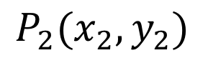
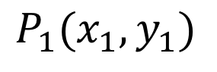
Points
$$P_{2}(x_{2},y_{2})$$
$$P_{1}(x_{1},y_{1})$$

Slide 19
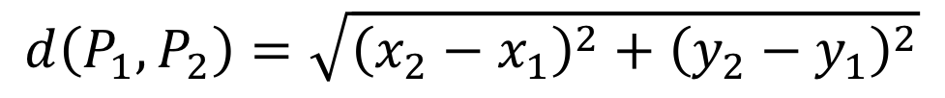
Euclidean Distance
$$d\left(P_{1},P_{2}\right)=\sqrt{{\left(x_{2}−x_{1}\right)}^{2}+{\left(y_{2}−y_{1}\right)}^{2}}$$
$$P_{2}(x_{2},y_{2})$$
$$P_{1}(x_{1},y_{1})$$

Slide 20
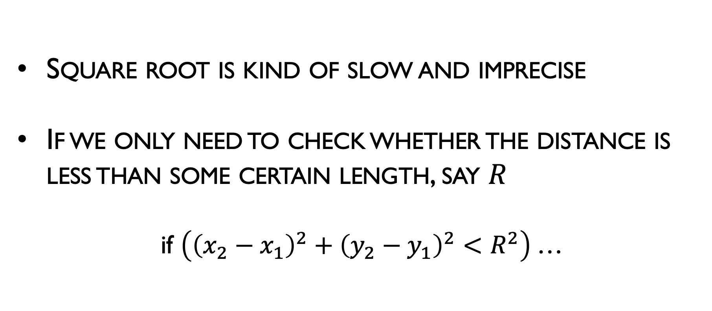
Euclidean Distance
Square root is kind of slow and imprecise
If we only need to check whether the distance is less than some certain length, say $R$
if $\left({\left(x_{2}−x_{1}\right)}^{2}+{\left(y_{2}−y_{1}\right)}^{2}<R^{2}\right)$…

Slide 21
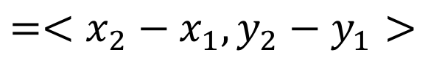
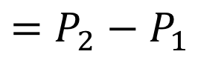
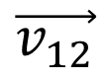
Vectors
$$\vec{v_{12}}$$
$$=P_{2}−P_{1}$$
$$=<x_{2}−x_{1},y_{2}−y_{1}>$$
$$P_{2}(x_{2},y_{2})$$
$$P_{1}(x_{1},y_{1})$$

Slide 22
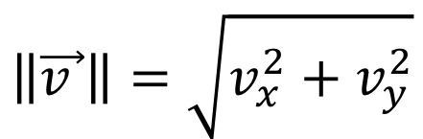
Vector Length/Magnitude
$$\left\|\vec{v }\right\|=\sqrt{v_{x}^{2}+v_{y}^{2}}$$

Slide 23
Vector Length/Magnitude
$$\left\|\vec{v }\right\|=\sqrt{v_{x}^{2}+v_{y}^{2}}$$
Equivalent to Euclidean distance…

Slide 24
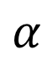
Vector Angle
$$α$$

Slide 25
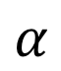
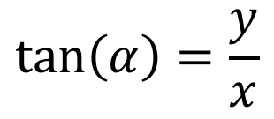
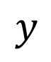
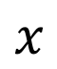
Vector Angle
$$α$$
$$y$$
$$α$$
$$x$$
$$\tan\left(α\right)=\frac{y}{x}$$

Slide 26
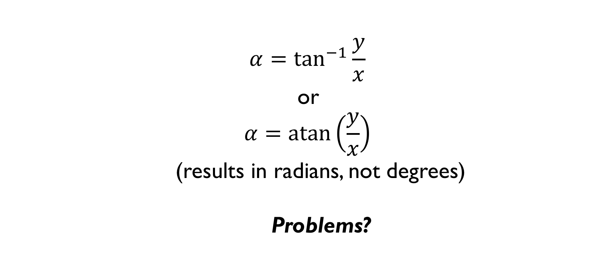
Vector Angle
$$α=\tan^{−1}{\frac{y}{x}}$$
or
$$α=\operatorname{atan}\left(\frac{y}{x}\right)$$
(results in radians, not degrees)
Problems?

Slide 27
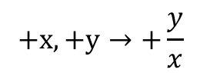
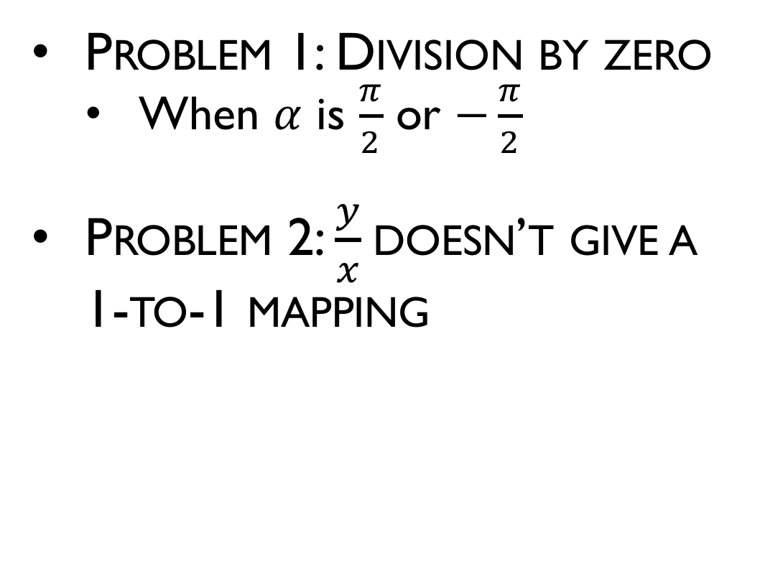
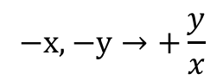
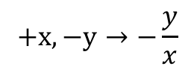
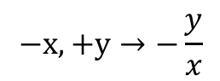
Vector Angle
Problem 1: Division by zero
When $α$ is $\frac{π}{2}$ or $−\frac{π}{2}$
Problem 2: $\frac{y}{x}$doesn’t give a 1-to-1 mapping
$$−x,+y→−\frac{y}{x}$$
$$+x,+y→+\frac{y}{x}$$
$$−x,−y→+\frac{y}{x}$$
$$+x,−y→−\frac{y}{x}$$

Slide 28
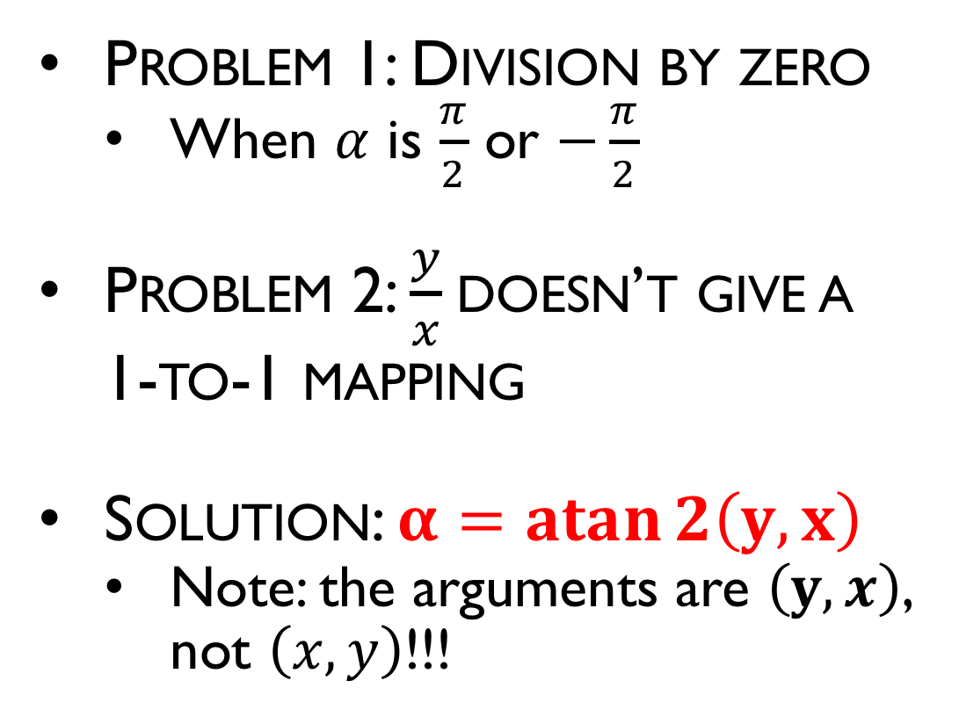
Vector Angle
Problem 1: Division by zero
When $α$ is $\frac{π}{2}$ or $−\frac{π}{2}$
Problem 2: $\frac{y}{x}$doesn’t give a 1-to-1 mapping
Solution: $α=\operatorname{atan}{2\left(y,x\right)}$
Note: the arguments are $\left(y,x\right)$, not $\left(x,y\right)$!!!
$$−x,+y→−\frac{y}{x}$$
$$+x,+y→+\frac{y}{x}$$
$$−x,−y→+\frac{y}{x}$$
$$+x,−y→−\frac{y}{x}$$

Slide 29
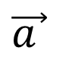
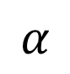
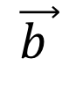
Angle Between 2 Vectors
$$\vec{b }$$
$$α$$
$$\vec{a }$$

Slide 30
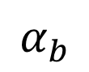
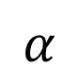
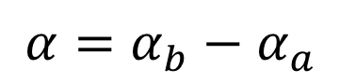
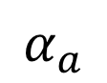
Angle Between 2 Vectors
$$\vec{b }$$
$$α$$
$$α_{b}$$
$$\vec{a }$$
$$α_{a}$$
$${α=α}_{b}−α_{a}$$

Slide 31
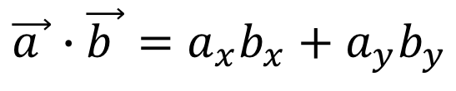
Dot Product
$$\vec{b }$$
$$\vec{a }$$
$$\vec{a }∙\vec{b }=a_{x}b_{x}+a_{y}b_{y}$$

Slide 32
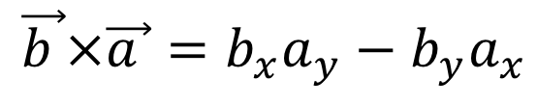
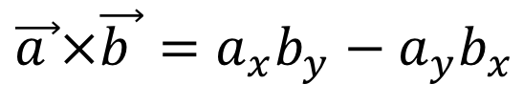
Cross Product
$$\vec{b }$$
$$\vec{a }×\vec{b }=a_{x}b_{y}−a_{y}b_{x}$$
$$\vec{a }$$
$$\vec{b }×\vec{a }=b_{x}a_{y}−b_{y}a_{x}$$

Slide 33
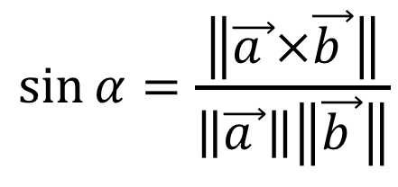
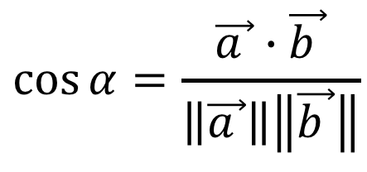
Angle Between 2 Vectors
$$\vec{b }$$
$$α$$
$$\vec{a }$$
$$\cos{α}=\frac{\vec{a }∙\vec{b }}{\left\|\vec{a }\right\|\left\|\vec{b }\right\|}$$
$$\sin{α}=\frac{\left\|\vec{a }×\vec{b }\right\|}{\left\|\vec{a }\right\|\left\|\vec{b }\right\|}$$

Slide 34
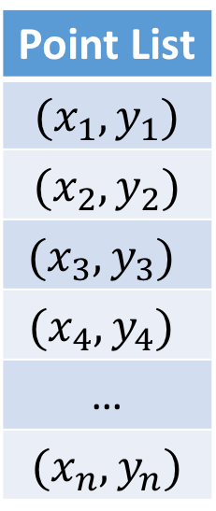
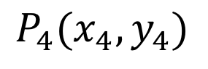
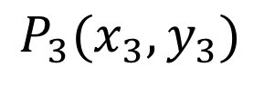
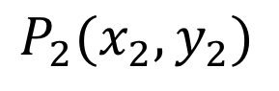
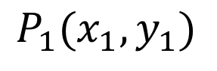
Storing Points
Point List
$$(x_{1},y_{1})$$
$$(x_{2},y_{2})$$
$$(x_{3},y_{3})$$
$$(x_{4},y_{4})$$
…
$$(x_{n},y_{n})$$
$$P_{4}(x_{4},y_{4})$$
$$P_{2}(x_{2},y_{2})$$
$$P_{1}(x_{1},y_{1})$$
$$P_{3}(x_{3},y_{3})$$

Slide 35
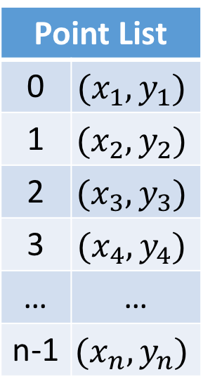
Storing Edges as Indices
Edge List
0 | 3
1 | 3
2 | 3
0 | 1
…
Point List
0 | $$(x_{1},y_{1})$$
1 | $$(x_{2},y_{2})$$
2 | $$(x_{3},y_{3})$$
3 | $$(x_{4},y_{4})$$
… | …
n-1 | $$(x_{n},y_{n})$$
$$P_{4}(x_{4},y_{4})$$
$$P_{2}(x_{2},y_{2})$$
$$P_{1}(x_{1},y_{1})$$
$$P_{3}(x_{3},y_{3})$$

Slide 36
Storing Points as Pointers
Edge List
…
Point List
$$(x_{1},y_{1})$$
$$(x_{2},y_{2})$$
$$(x_{3},y_{3})$$
$$(x_{4},y_{4})$$
…
$$(x_{n},y_{n})$$
$$P_{4}(x_{4},y_{4})$$
$$P_{2}(x_{2},y_{2})$$
$$P_{1}(x_{1},y_{1})$$
$$P_{3}(x_{3},y_{3})$$

Slide 37
Storing Triangles with Indices
Triangle List
0 | 1 | 2
0 | 1 | 3
…
Point List
0 | $$(x_{1},y_{1})$$
1 | $$(x_{2},y_{2})$$
2 | $$(x_{3},y_{3})$$
3 | $$(x_{4},y_{4})$$
… | …
n-1 | $$(x_{n},y_{n})$$
$$P_{4}(x_{4},y_{4})$$
$$P_{2}(x_{2},y_{2})$$
$$P_{1}(x_{1},y_{1})$$
$$P_{3}(x_{3},y_{3})$$

Slide 38
Storing Triangles with Indices
clockwise
Triangle List
0 | 1 | 2
0 | 1 | 3
…
Point List
0 | $$(x_{1},y_{1})$$
1 | $$(x_{2},y_{2})$$
2 | $$(x_{3},y_{3})$$
3 | $$(x_{4},y_{4})$$
… | …
n-1 | $$(x_{n},y_{n})$$
$$P_{4}(x_{4},y_{4})$$
$$P_{2}(x_{2},y_{2})$$
counterclockwise
$$P_{1}(x_{1},y_{1})$$
$$P_{3}(x_{3},y_{3})$$

Slide 39
Storing Polygons with Indices
Polygon List
0 | 2 | 1 | 3
…
Point List
0 | $$(x_{1},y_{1})$$
1 | $$(x_{2},y_{2})$$
2 | $$(x_{3},y_{3})$$
3 | $$(x_{4},y_{4})$$
… | …
n-1 | $$(x_{n},y_{n})$$
$$P_{4}(x_{4},y_{4})$$
$$P_{2}(x_{2},y_{2})$$
$$P_{1}(x_{1},y_{1})$$
$$P_{3}(x_{3},y_{3})$$

Slide 40
Storing Polygons with Indices
Polygon List
0 | 2 | 1 | 3
…
Point List
0 | $$(x_{1},y_{1})$$
1 | $$(x_{2},y_{2})$$
2 | $$(x_{3},y_{3})$$
3 | $$(x_{4},y_{4})$$
… | …
n-1 | $$(x_{n},y_{n})$$
$$P_{4}(x_{4},y_{4})$$
$$P_{2}(x_{2},y_{2})$$
$$P_{1}(x_{1},y_{1})$$
$$P_{3}(x_{3},y_{3})$$

Slide 41
Storing Polygons with Indices
Polygon List
0 | 1 | 2 | 3
…
Point List
0 | $$(x_{1},y_{1})$$
1 | $$(x_{2},y_{2})$$
2 | $$(x_{3},y_{3})$$
3 | $$(x_{4},y_{4})$$
… | …
n-1 | $$(x_{n},y_{n})$$
$$P_{4}(x_{4},y_{4})$$
$$P_{2}(x_{2},y_{2})$$
Take care with order
$$P_{1}(x_{1},y_{1})$$
$$P_{3}(x_{3},y_{3})$$

Slide 42
Linear Interpolation
$$P_{2}(x_{2},y_{2})$$
$$P_{1}(x_{1},y_{1})$$

Slide 43
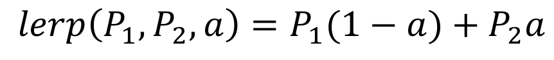
Linear Interpolation
$$P_{2}(x_{2},y_{2})$$
$$P_{1}(x_{1},y_{1})$$
$$lerp\left(P_{1},P_{2},a\right)=P_{1}(1−a)+P_{2}a$$

Slide 44
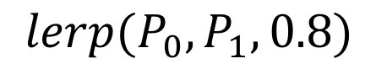
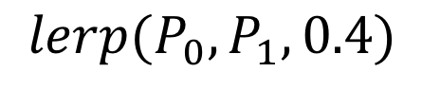
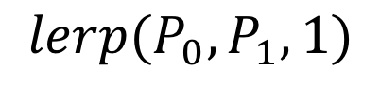
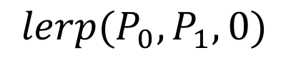
Linear Interpolation
$$lerp(P_{0},P_{1},1)$$
$$lerp(P_{0},P_{1},0.8)$$
$$P_{2}(x_{2},y_{2})$$
$$lerp(P_{0},P_{1},0.4)$$
$$lerp(P_{0},P_{1},0)$$
$$P_{1}(x_{1},y_{1})$$
$$lerp\left(P_{1},P_{2},a\right)=P_{1}(1−a)+P_{2}a$$

Slide 45
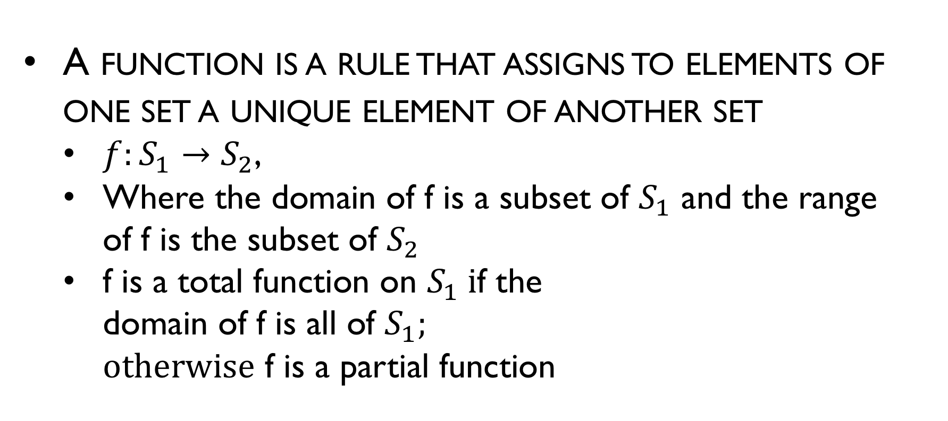
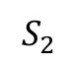


Functions
A function is a rule that assigns to elements of one set a unique element of another set
$f:S_{1}→S_{2}$,
Where the domain of f is a subset of $S_{1}$ and the range of f is the subset of $S_{2}$
f is a total function on $S_{1} i$f the domain of f is all of $S_{1};$ $otherwise$ f is a partial function
$$S_{1}$$
$$f$$
$$S_{2}$$
2
4
6
1
3
5
Notes:
$Ω$ big omega
$Θ$ big theta

Slide 46


Relations
Some functions can be represented by a set of pairs $\{\left(x_{1},y_{1}\right),\left(x_{2},y_{2}\right),…\}$, where $x_{i}$ is an element in the domain of the function, and${ y}_{i}$ is the corresponding value in its range
For such a set to define a function, each $x_{i}$can occur at most once as the first element of a pair.
If this is not satisfied, the set is called a relation.
$$S_{1}$$
$$R$$
$$S_{2}$$
2
4
6
1
3
5

Slide 47

Functions
The behavior of functions:
Big O
f has order at most g
$f\left(n\right)≤c\left|g\left(n\right)\right|→f\left(n\right)=O\left(g\left(n\right)\right)$
Big Omega
f has order at least g
$\left|f\left(n\right)\right|≥c\left|g\left(n\right)\right|→f\left(n\right)=Ω(g\left(n\right))$
Big Theta
f has the same order of magnitude as g
$c_{1}|g\left(n\right)|≤\left|f\left(n\right)\right|≤c_{2}|g\left(n\right)|→f\left(n\right)=Θ\left(g\left(n\right)\right)$
Notes:
$Ω$ big omega
$Θ$ big theta

Slide 48

Function Examples
$f\left(n\right)=2n^{2}+4n,$
$g\left(n\right)=n^{3},$
$h\left(n\right)=9n^{2}+300$

Slide 49


Function Examples
$f\left(n\right)=2n^{2}+4n,$
$g\left(n\right)=n^{3},$
$h\left(n\right)=9n^{2}+300$
$f\left(n\right)=O(g\left(n\right)),$
$g\left(n\right)=Ω(h\left(n\right)),$
$f\left(n\right)=Θ\left(h\left(n\right)\right)$
$$O\left(n\right)+O\left(n\right)=2(O(n))?$$

Slide 50








Graphs and trees
A graph is construct of two finite sets
Vertices, $V=\left\{v_{1},v_{2},…,v_{n}\right\}$; Edges, E$=\left\{e_{1},e_{2},…,e_{m}\right\}$
A walk from $v_{i}$ to $v_{n}$ is a sequence of edges $\left(v_{i},v_{j}\right), \left(v_{j},v_{k}\right),…, (v_{m},v_{n})$
A path is a walk in which no edge is repeated
A simple path is a path in which no vertex is repeated
A cycle with base $v_{i}$ is a walk from $v_{i}$ to itself with no repeated edges
A loop is an edge from a vertex to itself
$$v_{1}$$
$$e_{1}$$
$$e_{3}$$
$$e_{2}$$
$$v_{2}$$
$$e_{4}$$
$$v_{3}$$

Slide 51
Trees
A tree is a directed graph that has no cycles, and that has one distinct vertex (the root)
Root
Parent
Height
Node
Child
Leaf

Slide 52

Proof techniques
A proof is a sequence of steps that lead from some known facts to the desired conclusion; each step must be obviously correct
Proof by contradiction:
To prove some fact P, we show that “not P” is false
That is, we suppose “not P” and demonstrate that it leads to an obviously wrong result
E.g.: Prove that$\sqrt{2 }$ is not rational. Suppose that is rational, that is $\sqrt{2}=\frac{m}{n}$, where n and m do not have common factors

Slide 53

Proof techniques
Proof by induction
We show that some fact is true for every natural number n, using two arguments:
Base: It is true for $n =1$ (or for some small number)
Step: If it is true for n, then it is true for $n+1$
E.g.: prove that $1+2+…+n =n(n+1)/2$

